Slide 1
Brandon Huzil and Viktor Fries
CS 476 Project
Egg Runner
The game

Slide 2
Problems
And
Motivations
When confronted with the task of deciding what to do for our Software Development Project, it became clear that we needed to work on a project that interested us and challenged us to learn skills that are good to have for the industry, and learn skills we would enjoy learning.
We decided that we would like to work on a game for our project, but what kind of game should we make, and how can we make a game that required us to use 3-tier software architecture.

Slide 3
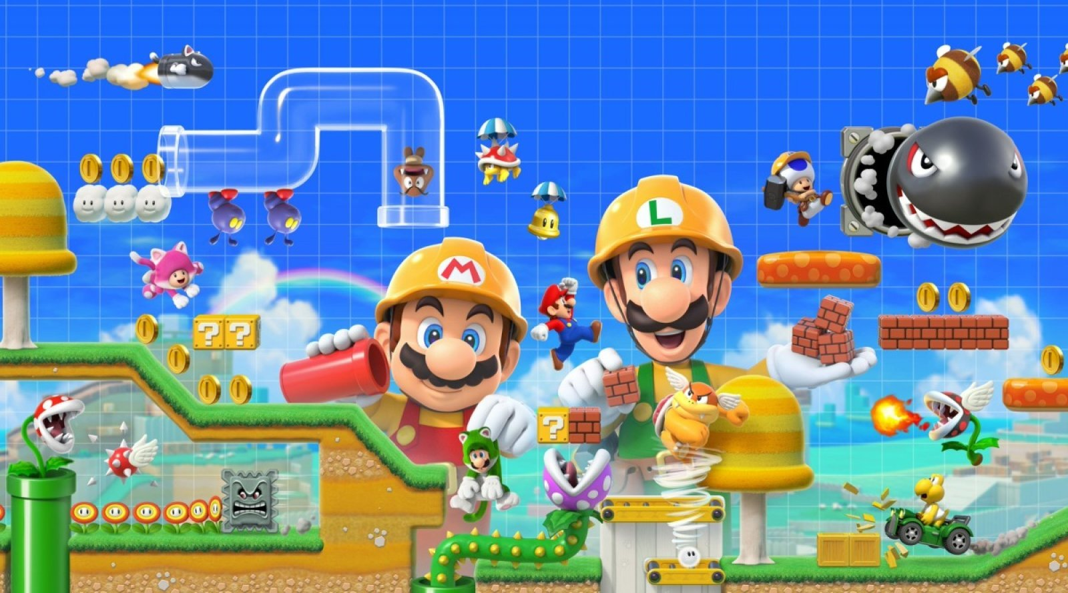
We looked at the current world of gaming for inspiration and found the perfect inspiration.
2015s Super Mario Maker and 2019s Super Mario Maker 2 by Nintendo found high success and ratings by taking the tried and true 2D Mario formula but gave players the tools to make their own levels and play the levels of others in the community. Unfortunately, if you wanted to play either game you needed both the games and the appropriate console. We wanted to tackle this problem.
We set out to create a simple online platformer, that included both a level editor, and a database of player made levels to play.

Slide 4
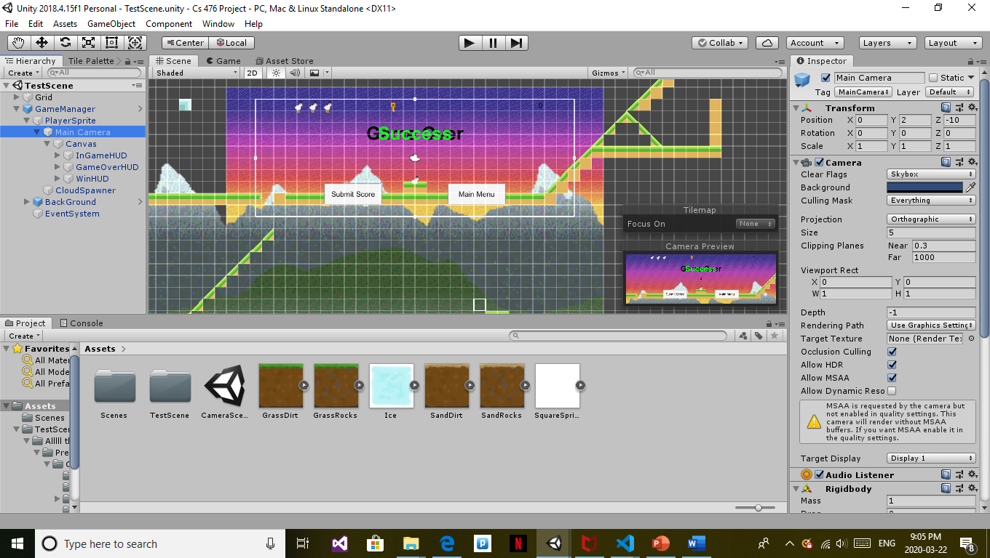
Main Functional requirements
We wanted the game logic to include a playable character with specialized camera, a collectible item for points, an enemy type to avoid that can trigger loss of health and death in the character, and a power up that can be used to destroy the enemy type.
We needed a level editor component that allowed users to place different tiles, as well as all the collectibles, power ups, and enemies. The editor should also allow players to save their level to the database.
We needed a database to store levels and high scores, and retrieve them when needed.

Slide 5
Design Patterns
In order to efficiently incorporate each game mechanic we made use of the spiral design pattern with a heavy focus on prototyping mechanics as they were added.
Determine a mechanic to add
Make use of prototyping to determine game logic implementation and iterate
Ensure Quality and that feature fits in both game logic and editor
Implement the prototype to work with existing mechanics and code

Slide 6
This model allowed us to add in components one at a time, while always having some semblance of a functional game.
Our parallax background effect was easy to add because of this model. It works by leap frogging two tileable images over each other as a character moves side to side to create a never ending background layered sense of depth. We had a deliverable product before the element was added and after it was added.
Other aspects of the project were already functional before this was implemented, and because most mechanics were not dependent on other ones it was easy to implement new features we discovered were necessary. This meant that if not all milestones were met we still had a usable product, and we could easily add new mechanics after reaching all milestones.

Slide 7
Design Patterns
Cont…
We also took inspiration form other design patterns for construction of certain components of our game, the mediator behavioural pattern worked wonders to lowly couple the communication between how we read a level and how we build a level.
The GameManager prefab object handled instantiation of all game objects at the correct locations and served to couple all game objects together with a common set of parent variables such to ensure all local coordinates were based off of the global coordinates so one objects (x = 3, y = -10, z = 0) is another objects (x = 3, y = -10, z = 0).

Slide 8
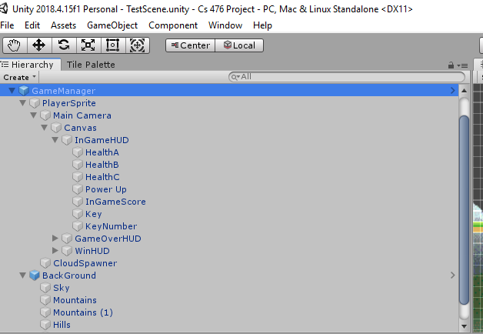
public void InitializeDoors()
{
// ensures all doors are closed
if (doors.Length > 0)
{
foreach (GameObject d in doors)
{
d.GetComponent<BoxCollider2D>().enabled = true;
d.GetComponent<SpriteRenderer>().color = new Color(1f, 1f, 1f, 1f);
}
}
// spawn in the doors at the correct locations
Quaternion roation = new Quaternion(0, 0, 0, 1);
doors = new GameObject[doorLocations.Length];
int i = 0;
foreach(Vector3 location in doorLocations)
{
doors[i++] = Instantiate(door, location, roation);
}
}

Slide 9
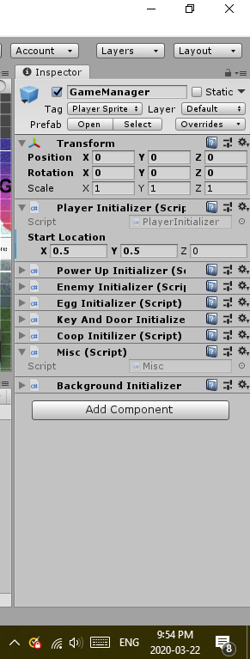
using System.Collections;
using System.Collections.Generic;
using UnityEngine;
public class BackgroundInitializer : MonoBehaviour
{
void Awake()
{
transform.GetChild(1).GetChild(0).GetComponent<SkyMover>().player = transform.GetChild(0).gameObject;
transform.GetChild(1).GetChild(1).GetComponent<MountainMover>().player = transform.GetChild(0).gameObject;
transform.GetChild(1).GetChild(1).GetComponent<MountainMover>().order = 2;
transform.GetChild(1).GetChild(2).GetComponent<MountainMover>().player = transform.GetChild(0).gameObject;
transform.GetChild(1).GetChild(2).GetComponent<MountainMover>().order = 1;
transform.GetChild(1).GetChild(3).GetComponent<HillMover>().player = transform.GetChild(0).gameObject;
transform.GetChild(1).GetChild(3).GetComponent<HillMover>().order = 2;
transform.GetChild(1).GetChild(4).GetComponent<HillMover>().player = transform.GetChild(0).gameObject;
transform.GetChild(1).GetChild(4).GetComponent<HillMover>().order = 1;
}
}

Slide 10
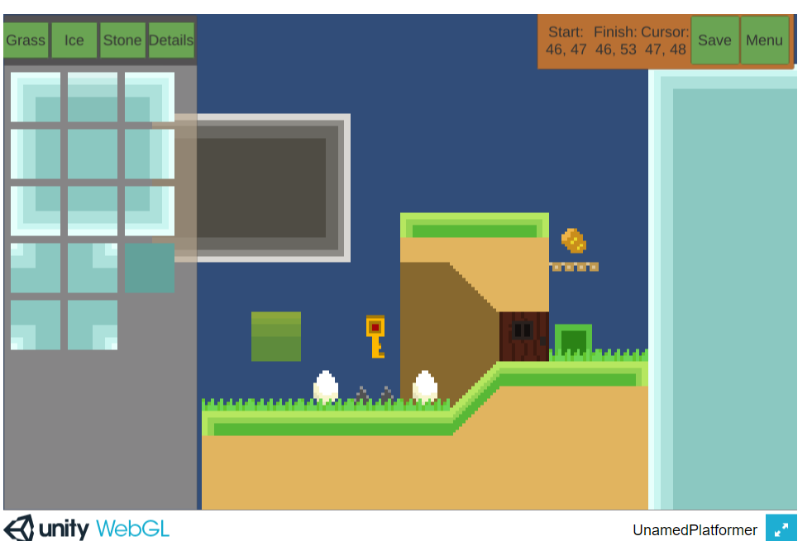
Level Editor
Allowing players to create varying levels that were mechanically interesting was really important to us.
Using multiple tile layers allows different types of terrain to have different interactions with the player, such as one directional collision platforms, purely decorative objects like grass, and even collectible objects like keys and eggs.
The layers are all behind the scenes as far the player is concerned. All they need to do is select what tile they’d like to place from the panel on the left, and place it in the world by clicking.
Saving the level is accomplished by converting the tilemaps into strings that can be read when the level is loaded, and converted back into tilemaps. To compress the size of the strings, if multiple tiles appear in a row, they are represented in the string by a single instance of the tile id, followed by a number for how many times that tile appears.

Slide 11

Software
Development
Tools
To make our game we used the popular game engine Unity, which uses C# for all of its scripting. Database requests are handled using PHP which interfaces with a MySQL database to retrieve levels and highscores.
Textures and sprites were made using Gimp.
UML diagrams were made with Visual Paradigm.

Slide 12
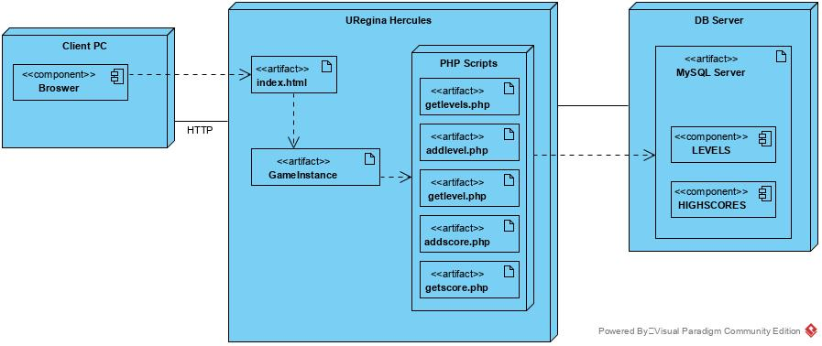
Class And Deployment Diagrams

Slide 13
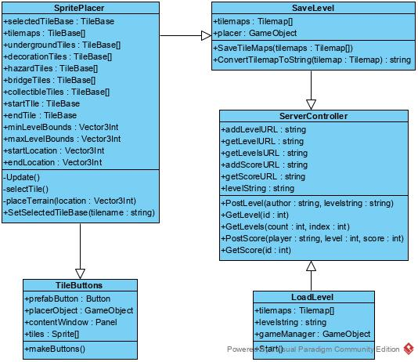
Class diagram of level editor components and some application layer components
These are just some of our class diagrams

Slide 14
Thanks for playing (we hope you will anyways)
Access our game at the following URL http://www2.cs.uregina.ca/~fries20v/CS476/
Have fun populating our databases with your own levels and playing each others hand crafted adventures.
Run Chicken Run

